Slide 1

PHYSICAL INTELLIGENCE & ASSURANCE · ENERGY & PROCESS
Qualified missions. Lower exposure. Defensible evidence.
NUCLEAR
OPERATIONAL PRESSURE
QUANTEON RESPONSE
Nuclear teams must reconcile plant configuration, radiation conditions, specialist judgement and inspection evidence while maintaining strict authority, traceability and change control.
Quanteon builds a living, versioned operating picture and qualifies each sensing mission against the asset state, route, payload, safeguards and named human authority.
MISSION PORTFOLIO
Illustrative mission patterns · platform and payload subject to site qualification
Primary-system condition route
Radiological area characterisation
Thermal · acoustic · 4K visual
Dose-rate · gamma spectrum · LiDAR
Containment high-bay survey
Operator and fixed-sensor reconciliation
Zoom visual · LiDAR · thermal
Rounds · historian · work context
IDEAL CUSTOMER PROFILE
START WITH ONE MISSION
• Plant operations and engineering
• Radiation protection
• Maintenance, outage and inspection leaders
Baseline one recurring thermal, acoustic or radiological route and the decision it must support.
ASSURED MISSION BASELINE
SCOPE A MISSION →
10 working days · CHF 25k fixed · no hardware purchase
Sources: IAEA PRIS Operational Reactor Age; IAEA SSG-48 Ageing Management; 10 CFR 20.1101 Radiation Protection. Full links in the Quanteon Knowledge Base.
Concept missions only. No certification, production-readiness or autonomous safety-authority claim is implied. Human authority remains explicit.
01

Slide 2
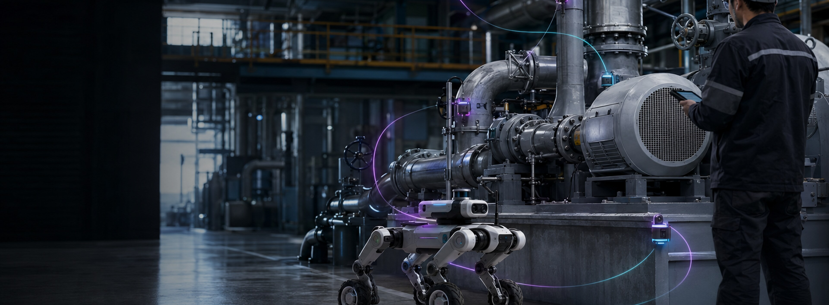
PHYSICAL INTELLIGENCE & ASSURANCE · ENERGY & PROCESS
Find the leak. Prove the response.
OIL & GAS
OPERATIONAL PRESSURE
QUANTEON RESPONSE
Distributed equipment, hazardous areas, ageing assets and intermittent inspection create gaps between alarms, field condition and the decision to continue, inspect or intervene.
Quanteon correlates process context, fixed detection, mobile sensing and human observations in a governed mission record—without making the robot the decision maker.
MISSION PORTFOLIO
Illustrative mission patterns · platform and payload subject to site qualification
Compressor integrity route
Methane and VOC screening
Vibration · thermal · acoustic
OGI · laser gas · wind
Flare and stack survey
Tank-farm assurance round
Long-wave thermal · zoom · LiDAR
Gas monitor · thermal · fixed fusion
IDEAL CUSTOMER PROFILE
START WITH ONE MISSION
• Operations and production
• Mechanical integrity and reliability
• Process safety, methane and inspection teams
Baseline one compressor, pipe-rack or tank-farm route with explicit evidence and escalation criteria.
ASSURED MISSION BASELINE
SCOPE A MISSION →
10 working days · CHF 25k fixed · no hardware purchase
Sources: EPA Oil and Gas Air Pollution Program; 49 CFR Part 192 Subpart O; EU Methane Regulation 2024/1787. Full links in the Quanteon Knowledge Base.
Concept missions only. No certification, production-readiness or autonomous safety-authority claim is implied. Human authority remains explicit.
02

Slide 3
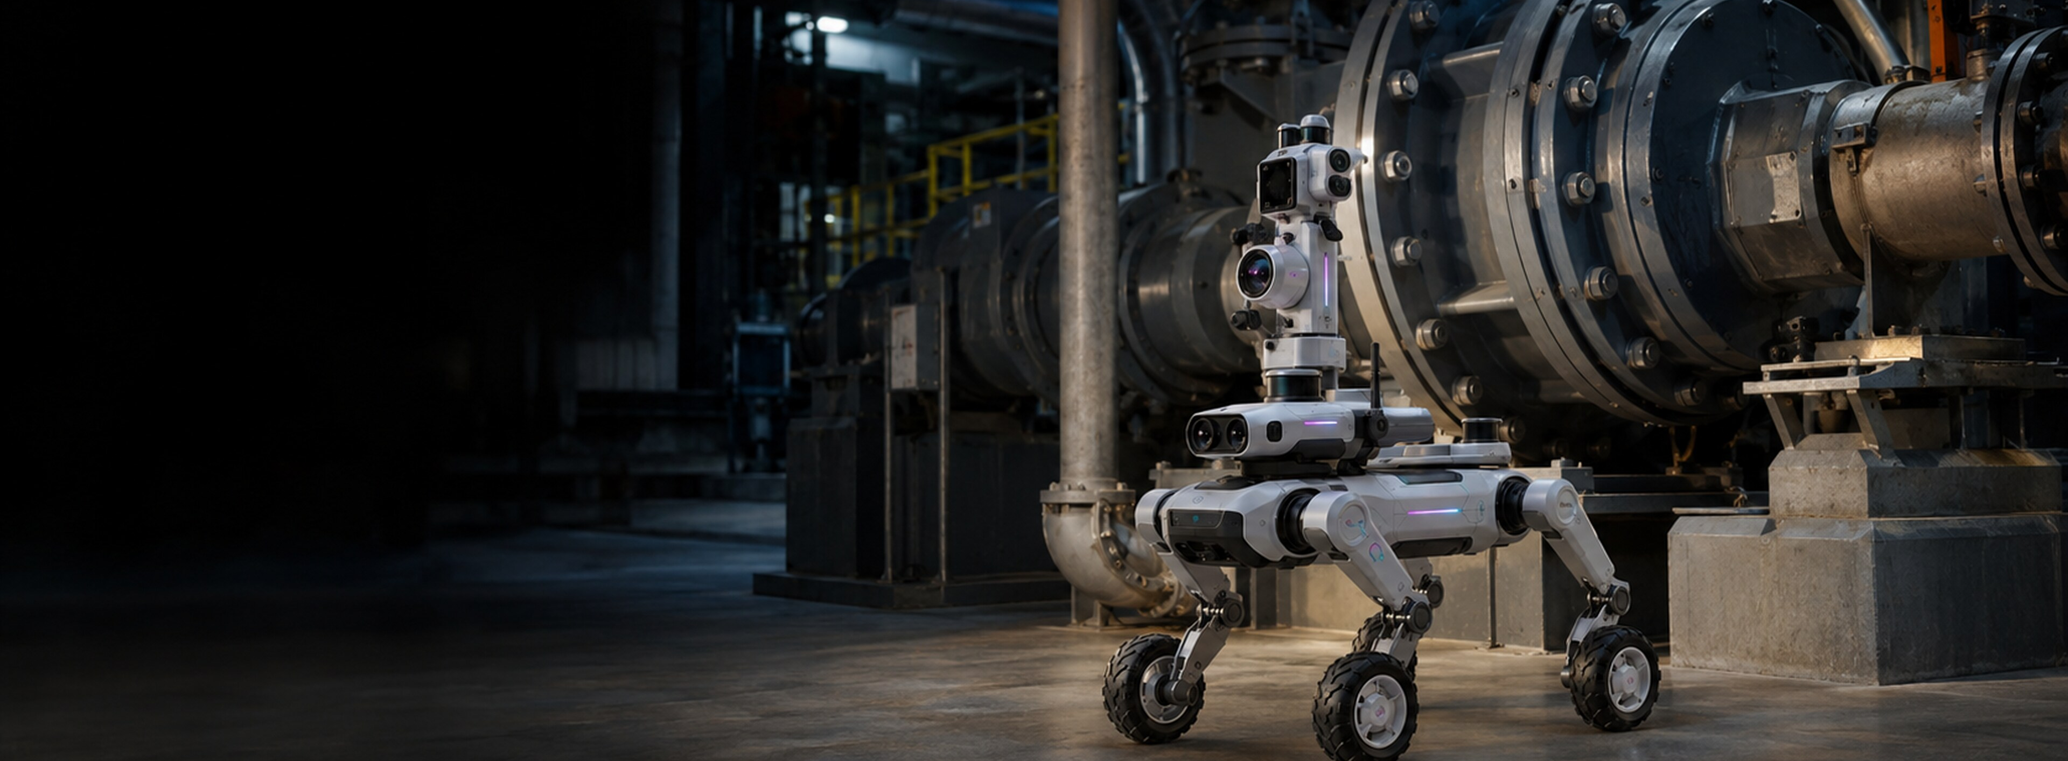
PHYSICAL INTELLIGENCE & ASSURANCE · ENERGY & PROCESS
See abnormal conditions. Govern the response.
CHEMICAL PROCESSING
OPERATIONAL PRESSURE
QUANTEON RESPONSE
Chemical plants depend on mechanical integrity and current operating context, yet evidence is split across detectors, rounds, inspection systems and documents.
Quanteon aligns what was observed, under which configuration and with what confidence—then binds review, escalation and action to the accountable operating workflow.
MISSION PORTFOLIO
Illustrative mission patterns · platform and payload subject to site qualification
Toxic and flammable gas patrol
Rotating-equipment condition round
Multi-gas · OGI · wind
Thermal · vibration · acoustic
Elevated pipework survey
Confined-space pre-entry map
Zoom visual · thermal · LiDAR
Gas · visual · geometry
IDEAL CUSTOMER PROFILE
START WITH ONE MISSION
• Plant and operations management
• Process safety and EHS
• Reliability, inspection and maintenance
Baseline one high-consequence route around pumps, piping, relief systems or storage.
ASSURED MISSION BASELINE
SCOPE A MISSION →
10 working days · CHF 25k fixed · no hardware purchase
Sources: OSHA Process Safety Management; EPA Risk Management Program; U.S. Chemical Safety Board. Full links in the Quanteon Knowledge Base.
Concept missions only. No certification, production-readiness or autonomous safety-authority claim is implied. Human authority remains explicit.
03

Slide 4
PHYSICAL INTELLIGENCE & ASSURANCE · ENERGY & PROCESS
Every turnaround minute counts. Every line-up must be right.
REFINING & PETROCHEMICALS
OPERATIONAL PRESSURE
QUANTEON RESPONSE
Hot equipment, dense pipe racks and constrained turnarounds make repeatable coverage difficult while mechanical-integrity evidence must remain current and defensible.
Quanteon qualifies repeatable routes, fuses them with plant context and preserves the evidence, assumptions, exceptions and approvals behind every integrity decision.
MISSION PORTFOLIO
Illustrative mission patterns · platform and payload subject to site qualification
Heater and refractory screening
Pipe-rack leak and corrosion route
Thermal · zoom visual · LiDAR
OGI · thermal · visual
Tank roof and seal survey
Compressor-train condition route
OGI · visual · thermal
Vibration · acoustic · thermal
IDEAL CUSTOMER PROFILE
START WITH ONE MISSION
• Refinery and operations leadership
• Asset integrity and inspection
• Turnaround, reliability and process safety
Baseline one heater, compressor train, pipe rack or tank system before scaling coverage.
ASSURED MISSION BASELINE
SCOPE A MISSION →
10 working days · CHF 25k fixed · no hardware purchase
Sources: OSHA Process Safety Management; CSB PEMEX Deer Park Investigation; EPA Petroleum Refinery Sector Rule. Full links in the Quanteon Knowledge Base.
Concept missions only. No certification, production-readiness or autonomous safety-authority claim is implied. Human authority remains explicit.
04

Slide 5
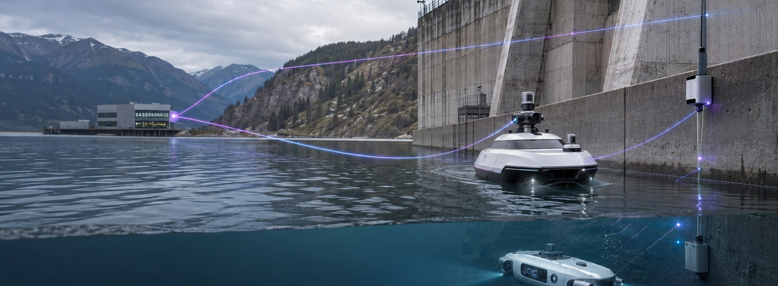
PHYSICAL INTELLIGENCE & ASSURANCE · ENERGY & PROCESS
One assured operating picture above, on and below the waterline.
OFFSHORE ENERGY
OPERATIONAL PRESSURE
QUANTEON RESPONSE
Offshore integrity work spans hazardous topsides, height, splash zones and subsea assets, with weather, logistics and limited specialist access complicating evidence continuity.
Quanteon coordinates aerial, ground, surface and subsea missions around one living twin and one traceable authority and evidence model.
MISSION PORTFOLIO
Illustrative mission patterns · platform and payload subject to site qualification
Topside leak patrol
Derrick and flare close visual
Gas array · OGI · thermal
Zoom · thermal · LiDAR
Splash-zone structural survey
Hull and intake screening
Imaging sonar · visual · CP
Side-scan · bathymetry · ROV visual
IDEAL CUSTOMER PROFILE
START WITH ONE MISSION
• Offshore installation and operations
• Structural, subsea and asset integrity
• Marine assurance, inspection and HSE
Baseline one topside leak patrol or structural survey and its marine operating envelope.
ASSURED MISSION BASELINE
SCOPE A MISSION →
10 working days · CHF 25k fixed · no hardware purchase
Sources: UK HSE Offshore Statistics 2024; BSEE Offshore Incident Statistics. Full links in the Quanteon Knowledge Base.
Concept missions only. No certification, production-readiness or autonomous safety-authority claim is implied. Human authority remains explicit.
05

Slide 6

PHYSICAL INTELLIGENCE & ASSURANCE · INDUSTRY & INFRASTRUCTURE
Turn inspection data into uptime decisions.
MANUFACTURING
OPERATIONAL PRESSURE
QUANTEON RESPONSE
High utilisation, scarce maintenance expertise and fragmented machine data make it hard to distinguish real condition change from inconsistent rounds and disconnected alarms.
Quanteon reconciles people, fixed monitoring, portable tools and mobile systems against a versioned baseline so maintenance teams can act on qualified evidence.
MISSION PORTFOLIO
Illustrative mission patterns · platform and payload subject to site qualification
Bottleneck equipment condition route
Compressed-air and steam loss survey
Thermal · vibration · acoustic
Ultrasound · thermal · context
Roof and elevated-asset survey
Safety and access verification
Visual · thermal · LiDAR
Video · access events · operator reports
IDEAL CUSTOMER PROFILE
START WITH ONE MISSION
• Plant and operations management
• Maintenance and reliability
• EHS, automation and digital operations
Baseline one recurring route around a bottleneck line, utility system or critical machine train.
ASSURED MISSION BASELINE
SCOPE A MISSION →
10 working days · CHF 25k fixed · no hardware purchase
Sources: Siemens True Cost of Downtime 2024; OSHA Control of Hazardous Energy; IFR World Robotics 2025. Full links in the Quanteon Knowledge Base.
Concept missions only. No certification, production-readiness or autonomous safety-authority claim is implied. Human authority remains explicit.
06

Slide 7

PHYSICAL INTELLIGENCE & ASSURANCE · SECURITY & RESPONSE
Every alarm becomes a governed, auditable mission.
CRITICAL INFRASTRUCTURE SECURITY
OPERATIONAL PRESSURE
QUANTEON RESPONSE
Security teams face high alarm volumes, mixed sensor quality, large perimeters and incomplete context when deciding whether to dismiss, investigate, isolate or escalate.
Quanteon fuses fixed security systems, access events, human reports and mobile verification while preserving who knew what, when and why action was authorised.
MISSION PORTFOLIO
Illustrative mission patterns · platform and payload subject to site qualification
Perimeter alarm verification
Restricted-area patrol
EO/IR · spotlight · geolocation
360° visual · thermal · audio
Access and video reconciliation
Waterside intrusion screening
CCTV · access events · analytics
Radar · thermal · visual
IDEAL CUSTOMER PROFILE
START WITH ONE MISSION
• Chief security / resilience officer
• Security operations
• Facilities, OT and emergency teams
Baseline one recurring perimeter, fence-line or restricted-area verification mission.
ASSURED MISSION BASELINE
SCOPE A MISSION →
10 working days · CHF 25k fixed · no hardware purchase
Sources: EU Critical Entities Resilience Directive; UK NPSA Building Protection. Full links in the Quanteon Knowledge Base.
Concept missions only. No certification, production-readiness or autonomous safety-authority claim is implied. Human authority remains explicit.
07

Slide 8
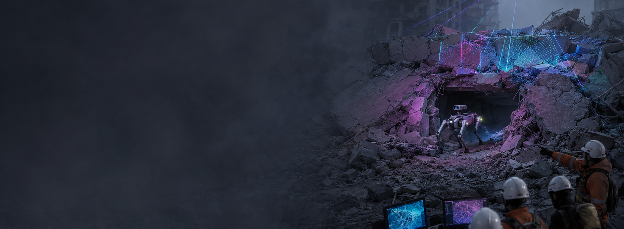
PHYSICAL INTELLIGENCE & ASSURANCE · SECURITY & RESPONSE
One search picture. Every sector accounted for.
SEARCH & RESCUE
OPERATIONAL PRESSURE
QUANTEON RESPONSE
Search areas evolve quickly, communications can be imperfect and observations arrive from crews, aircraft, dogs, sensors and the public with uneven location, time and confidence.
Quanteon assembles a live, uncertainty-aware search picture, coordinates qualified sensing missions and records tasking, findings and command decisions.
MISSION PORTFOLIO
Illustrative mission patterns · platform and payload subject to site qualification
Wide-area aerial search
Rubble and confined-area search
EO/IR · mapping · beacon receiver
Thermal · audio · visual
Water-surface search
Crew and sighting reconciliation
Thermal · radar · visual
Reports · tracks · photos · timestamps
IDEAL CUSTOMER PROFILE
START WITH ONE MISSION
• SAR and incident commanders
• Coast guard, mountain and urban rescue
• Public-safety aviation and UAS coordinators
Baseline one search pattern, evidence handoff and human confirmation workflow in a controlled exercise.
ASSURED MISSION BASELINE
SCOPE A MISSION →
10 working days · CHF 25k fixed · no hardware purchase
Sources: INSARAG Guidelines; NIST Emergency Response Robot Performance. Full links in the Quanteon Knowledge Base.
Concept missions only. No certification, production-readiness or autonomous safety-authority claim is implied. Human authority remains explicit.
08

Slide 9
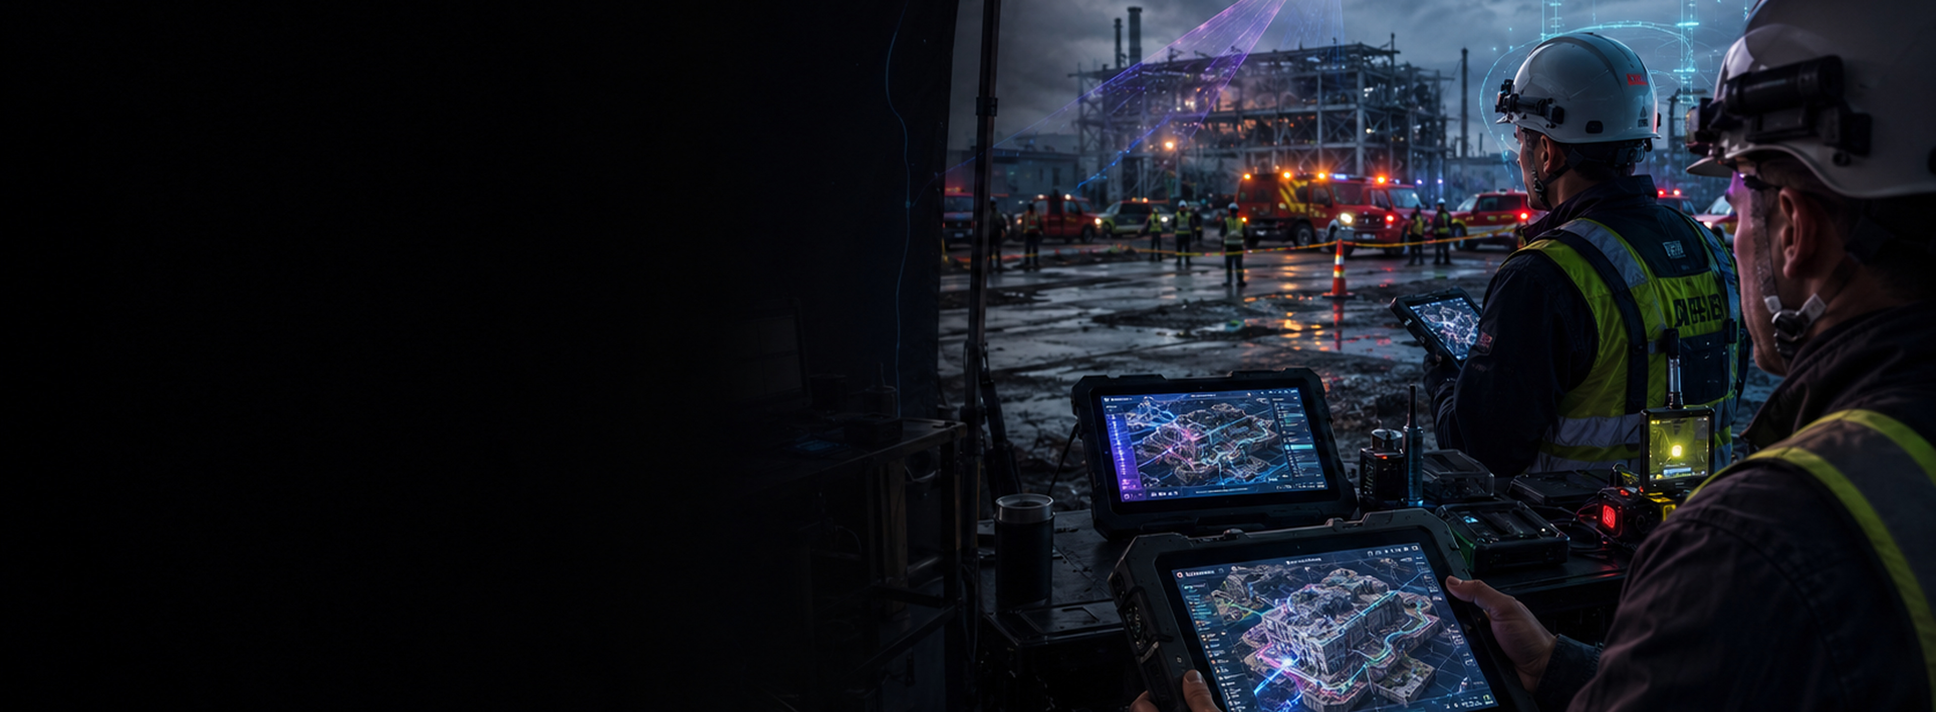
PHYSICAL INTELLIGENCE & ASSURANCE · SECURITY & RESPONSE
One operating picture. One command intent. Every action traceable.
FIRST RESPONDERS & EMERGENCY MANAGEMENT
OPERATIONAL PRESSURE
QUANTEON RESPONSE
Multi-agency incidents create rapidly changing maps, hazards, observations and resource decisions. Command must distinguish confirmed evidence from assumptions.
Quanteon aligns live sensing, responder reports, infrastructure context and mission status with explicit confidence, human authority and a complete decision record.
MISSION PORTFOLIO
Illustrative mission patterns · platform and payload subject to site qualification
Rapid incident-site twin
Hazard corridor reconnaissance
Mapping · LiDAR · EO/IR
Gas · radiation · thermal
Infrastructure damage assessment
Responder observation fusion
Zoom visual · thermal · LiDAR
Photos · voice · location · task status
IDEAL CUSTOMER PROFILE
START WITH ONE MISSION
• Emergency-management directors
• Incident command and public safety
• Civil protection, UAS and technical rescue teams
Baseline one damage-assessment or hazardous-area reconnaissance workflow in a tabletop and field exercise.
ASSURED MISSION BASELINE
SCOPE A MISSION →
10 working days · CHF 25k fixed · no hardware purchase
Sources: FEMA National Incident Management System; NIST Public Safety Communications Research. Full links in the Quanteon Knowledge Base.
Concept missions only. No certification, production-readiness or autonomous safety-authority claim is implied. Human authority remains explicit.
09

Slide 10
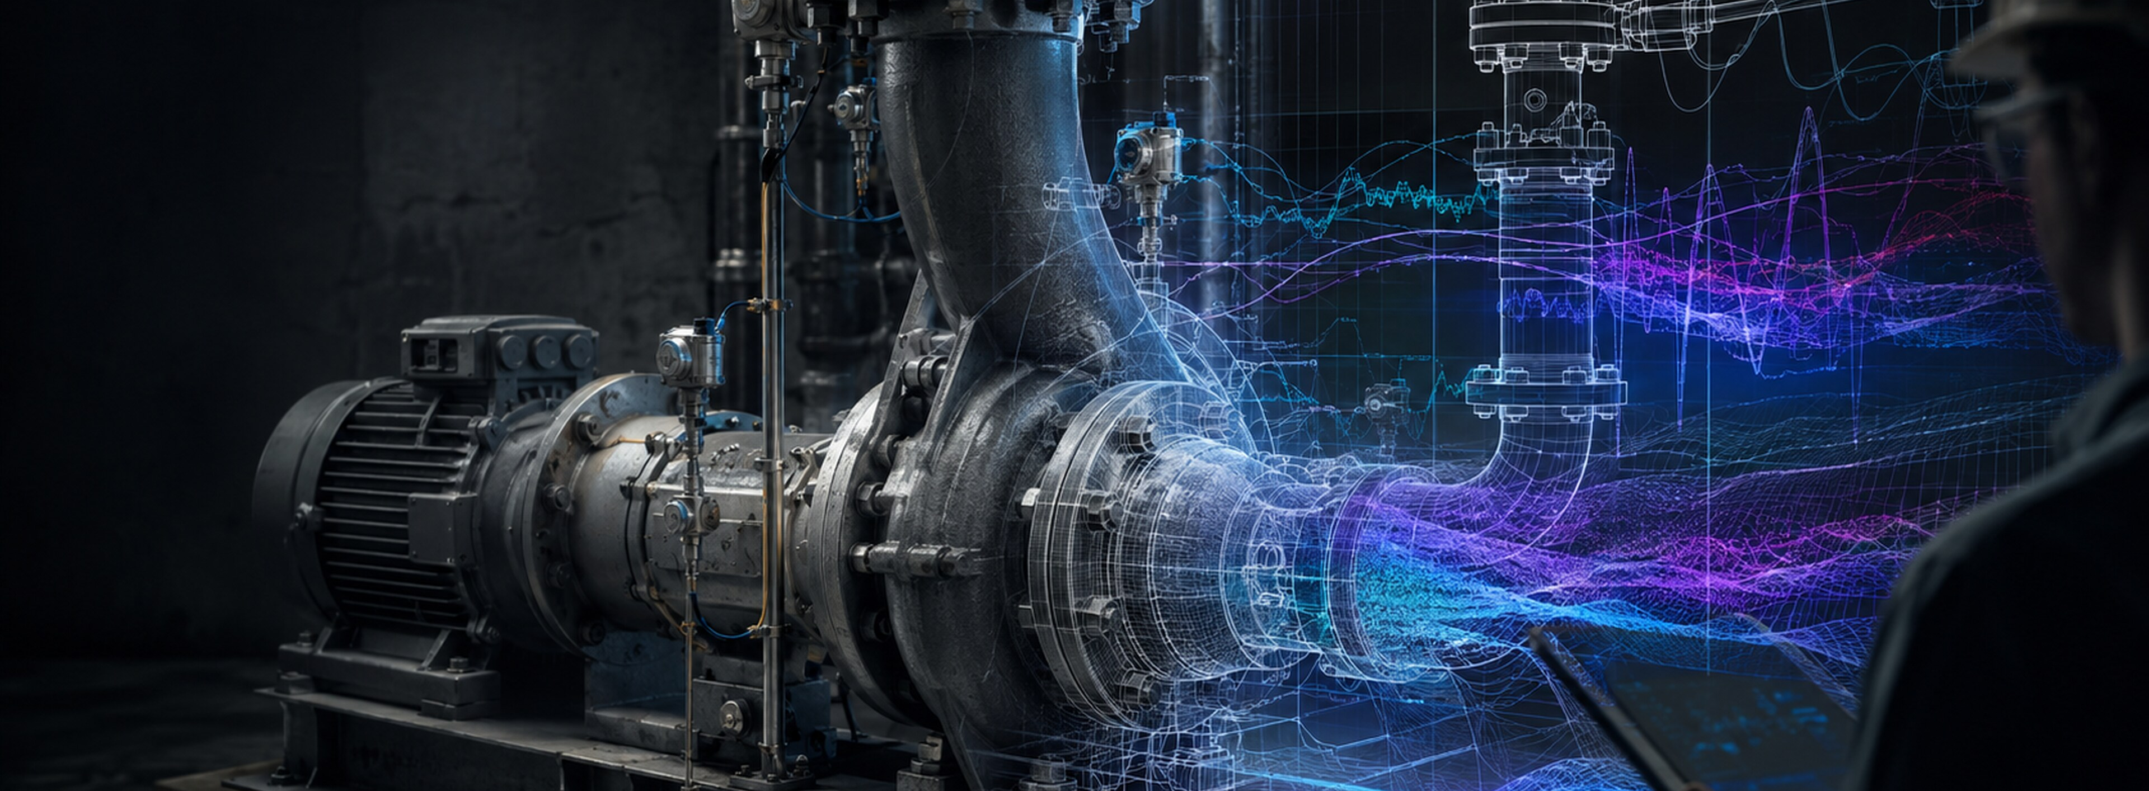
PHYSICAL INTELLIGENCE & ASSURANCE · SECURITY & RESPONSE
Know the hot zone before you send people in.
FIREFIGHTING & HAZMAT
OPERATIONAL PRESSURE
QUANTEON RESPONSE
Heat, smoke, toxic atmospheres, structural uncertainty and limited visibility make reconnaissance dangerous; readings still need expert context.
Quanteon coordinates remote sensing and responder judgement, keeps local safeguards authoritative and escalates consequential decisions to named incident-command roles.
MISSION PORTFOLIO
Illustrative mission patterns · platform and payload subject to site qualification
Thermal fireground overview
Toxic-atmosphere reconnaissance
Radiometric thermal · zoom · mapping
Multi-gas · PID · visual
Structural-change screening
Evidence and command timeline
LiDAR · visual · thermal
Radio logs · actions · conditions
IDEAL CUSTOMER PROFILE
START WITH ONE MISSION
• Fire chiefs and incident commanders
• HazMat and industrial fire brigades
• Safety officers and emergency planners
Baseline one pre-entry thermal, gas or structural reconnaissance mission in a controlled drill.
ASSURED MISSION BASELINE
SCOPE A MISSION →
10 working days · CHF 25k fixed · no hardware purchase
Sources: NIOSH Firefighter Safety and Health; OSHA HAZWOPER 29 CFR 1910.120; NIST Emergency Response Robot Performance. Full links in the Quanteon Knowledge Base.
Concept missions only. No certification, production-readiness or autonomous safety-authority claim is implied. Human authority remains explicit.
10

Slide 11
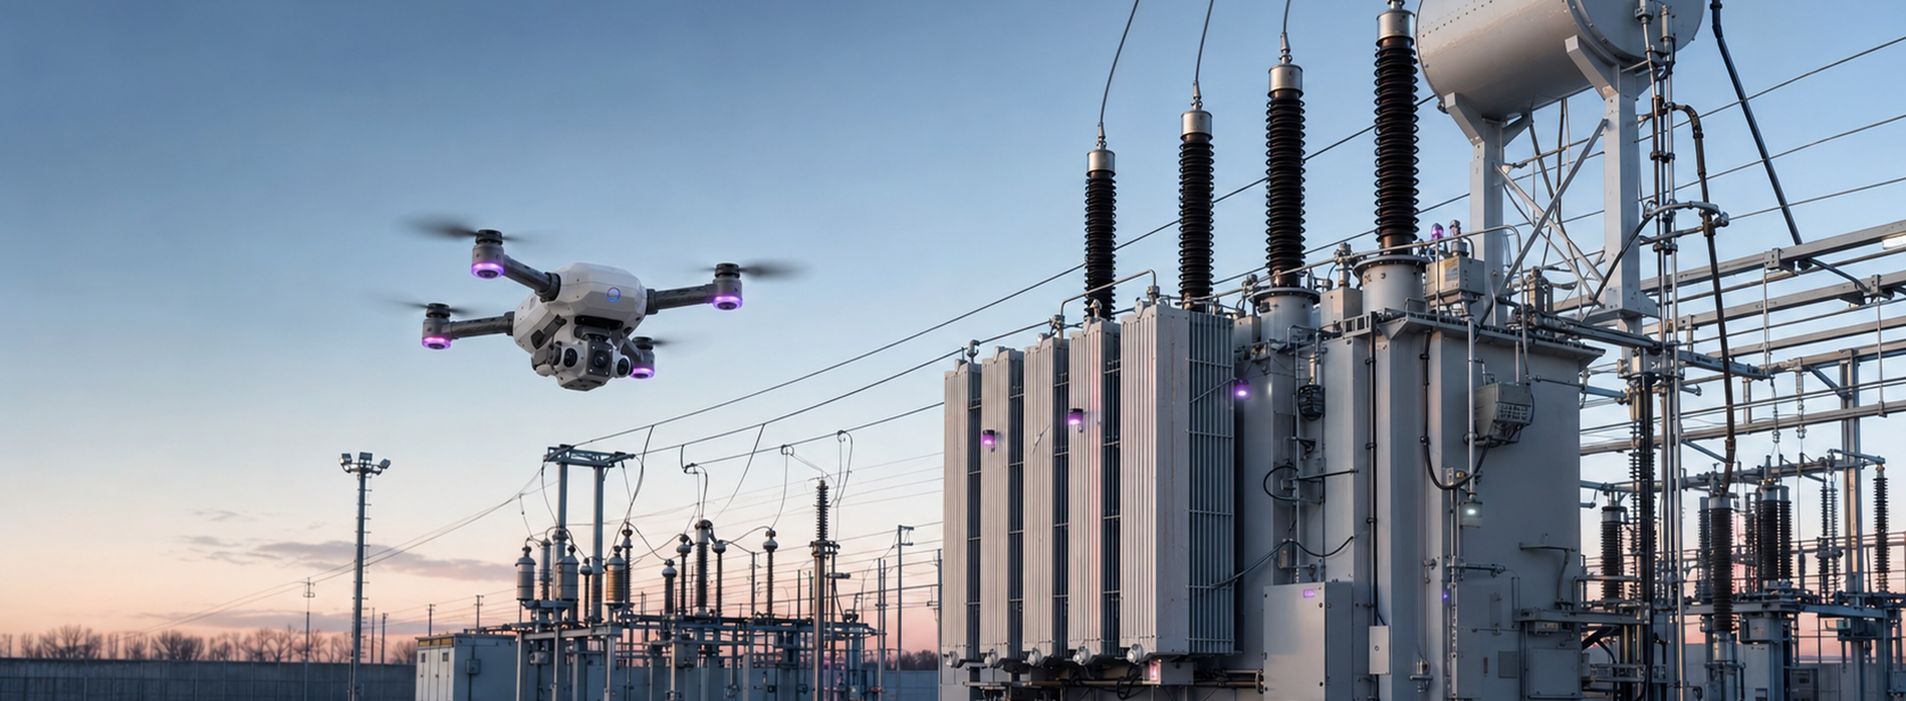
PHYSICAL INTELLIGENCE & ASSURANCE · INDUSTRY & INFRASTRUCTURE
Every substation, continuously mission-ready.
ELECTRIC UTILITIES
OPERATIONAL PRESSURE
QUANTEON RESPONSE
Utilities manage distributed, ageing assets while critical replacements can take years and field evidence remains split across patrols, monitoring, weather and work history.
Quanteon connects substation, line, vegetation and operator evidence to a living asset baseline and a governed inspect-or-intervene decision.
MISSION PORTFOLIO
Illustrative mission patterns · platform and payload subject to site qualification
Substation thermal and corona route
Transmission-line inspection
Thermal · UV · acoustic
Zoom · LiDAR · thermal
Underground-vault reconnaissance
Storm and wildfire damage map
Gas · thermal · visual
Mapping · thermal · visual
IDEAL CUSTOMER PROFILE
START WITH ONE MISSION
• Grid operations / asset management
• Substation and line maintenance
• Reliability, wildfire and resilience
Baseline one substation or line-inspection route tied to a maintenance or escalation decision.
ASSURED MISSION BASELINE
SCOPE A MISSION →
10 working days · CHF 25k fixed · no hardware purchase
Sources: IEA Building the Future Transmission Grid; NERC CIP-014-3. Full links in the Quanteon Knowledge Base.
Concept missions only. No certification, production-readiness or autonomous safety-authority claim is implied. Human authority remains explicit.
11

Slide 12
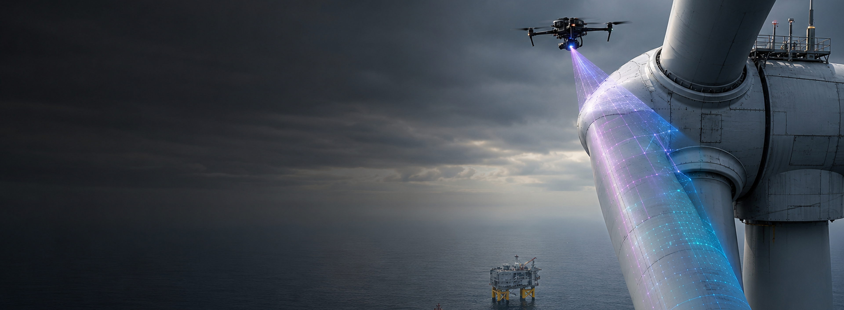
PHYSICAL INTELLIGENCE & ASSURANCE · INDUSTRY & INFRASTRUCTURE
Turn every turbine inspection into an asset decision.
WIND & RENEWABLE ENERGY
OPERATIONAL PRESSURE
QUANTEON RESPONSE
Distributed sites, weather windows, access at height and inconsistent inspection methods complicate the comparison of blade, tower, electrical and balance-of-plant condition over time.
Quanteon qualifies repeatable routes and reconciles findings against a time-aware baseline so owners can prioritise repair, monitor or continue operation.
MISSION PORTFOLIO
Illustrative mission patterns · platform and payload subject to site qualification
Blade surface survey
Tower and nacelle inspection
High-resolution visual · thermal
Zoom · LiDAR · thermal
Substation and converter route
Offshore foundation screening
Thermal · acoustic · visual
Sonar · visual · CP
IDEAL CUSTOMER PROFILE
START WITH ONE MISSION
• Renewable asset owners and operators
• Wind O&M and blade integrity
• Engineering, reliability and portfolio performance
Baseline one turbine or site-wide recurring inspection mission and its repair decision thresholds.
ASSURED MISSION BASELINE
SCOPE A MISSION →
10 working days · CHF 25k fixed · no hardware purchase
Sources: G+ Offshore Wind 2025 Incident Data; IEA Building the Future Transmission Grid. Full links in the Quanteon Knowledge Base.
Concept missions only. No certification, production-readiness or autonomous safety-authority claim is implied. Human authority remains explicit.
12

Slide 13
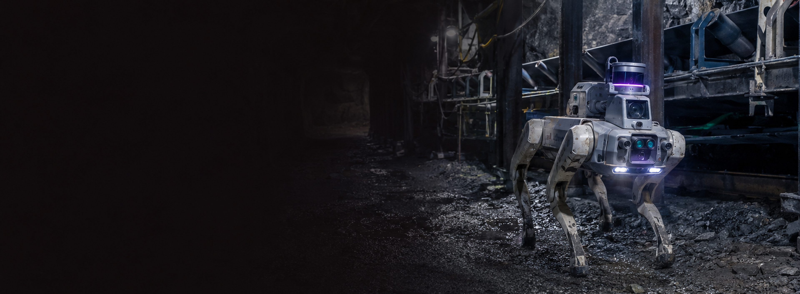
PHYSICAL INTELLIGENCE & ASSURANCE · INDUSTRY & INFRASTRUCTURE
Send evidence underground before people.
MINING
OPERATIONAL PRESSURE
QUANTEON RESPONSE
Ground conditions, dust, gas, mobile equipment and large remote footprints make inspection hazardous and make it difficult to preserve a consistent picture of rapidly changing operations.
Quanteon coordinates aerial, ground, fixed and human evidence around a living mine context, with mission limits, safe states and human authority made explicit.
MISSION PORTFOLIO
Illustrative mission patterns · platform and payload subject to site qualification
Underground gas and condition route
Highwall and stockpile survey
Gas · thermal · LiDAR
Photogrammetry · LiDAR · visual
Conveyor and crusher condition route
Tailings and water-balance survey
Thermal · vibration · acoustic
Mapping · thermal · water level
IDEAL CUSTOMER PROFILE
START WITH ONE MISSION
• Mine operations / technical services
• HSE, geotechnical and rescue
• Fixed-plant and tailings teams
Baseline one highwall, underground, conveyor or tailings inspection mission with a named decision owner.
ASSURED MISSION BASELINE
SCOPE A MISSION →
10 working days · CHF 25k fixed · no hardware purchase
Sources: Global Industry Standard on Tailings Management; MSHA Fatality Reports. Full links in the Quanteon Knowledge Base.
Concept missions only. No certification, production-readiness or autonomous safety-authority claim is implied. Human authority remains explicit.
13

Slide 14
PHYSICAL INTELLIGENCE & ASSURANCE · INDUSTRY & INFRASTRUCTURE
Keep cargo moving with evidence, not assumptions.
PORTS & TERMINALS
OPERATIONAL PRESSURE
QUANTEON RESPONSE
Ports combine open perimeters, vessels, cranes, hazardous cargo, ageing marine structures and continuous traffic—often across multiple operators and disconnected monitoring systems.
Quanteon aligns security, structural, environmental and operational evidence by location, time and authority so exceptions can be verified and acted on quickly.
MISSION PORTFOLIO
Illustrative mission patterns · platform and payload subject to site qualification
Quay-wall and berth survey
Crane and elevated structure route
Imaging sonar · visual · geometry
Zoom · thermal · LiDAR
Waterside security patrol
Perimeter and gate verification
Radar · thermal · visual
CCTV · access · mobile response
IDEAL CUSTOMER PROFILE
START WITH ONE MISSION
• Port authority and terminal operations
• Security, resilience and harbour master
• Marine structures, cranes and asset maintenance
Baseline one berth, quay-wall, crane or waterside-security mission with a shared decision workflow.
ASSURED MISSION BASELINE
SCOPE A MISSION →
10 working days · CHF 25k fixed · no hardware purchase
Sources: UNCTAD Review of Maritime Transport 2025; MARAD Port Infrastructure Development Program. Full links in the Quanteon Knowledge Base.
Concept missions only. No certification, production-readiness or autonomous safety-authority claim is implied. Human authority remains explicit.
14

Slide 15
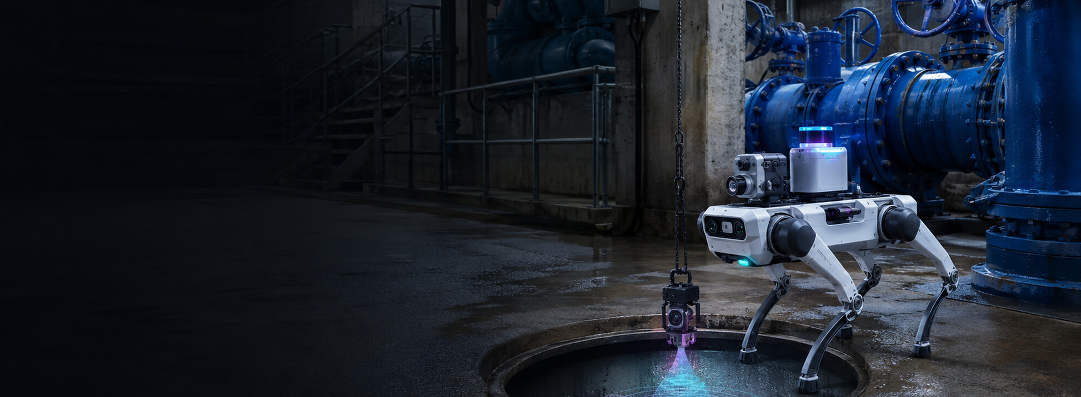
PHYSICAL INTELLIGENCE & ASSURANCE · INDUSTRY & INFRASTRUCTURE
Inspect the spaces people should not enter.
WATER & WASTEWATER
OPERATIONAL PRESSURE
QUANTEON RESPONSE
Utilities operate dispersed, ageing and often hard-to-access assets while leaks, blockages, corrosion, gas and equipment degradation compete for limited maintenance attention.
Quanteon combines network context, fixed instrumentation, inspection devices and field observations to qualify what changed and which intervention deserves priority.
MISSION PORTFOLIO
Illustrative mission patterns · platform and payload subject to site qualification
Pump-station condition route
Sewer and culvert inspection
Thermal · vibration · gas
Visual · sonar · gas
Tank and reservoir survey
Leak and overflow evidence fusion
Visual · thermal · mapping
Flow · level · reports · weather
IDEAL CUSTOMER PROFILE
START WITH ONE MISSION
• Water and wastewater utility leadership
• Operations, networks and treatment
• Maintenance, asset management and safety
Baseline one pump-station, sewer, tank or treatment-asset route tied to a work-order decision.
ASSURED MISSION BASELINE
SCOPE A MISSION →
10 working days · CHF 25k fixed · no hardware purchase
Sources: EPA 7th Drinking Water Infrastructure Needs Survey; OSHA Confined Spaces. Full links in the Quanteon Knowledge Base.
Concept missions only. No certification, production-readiness or autonomous safety-authority claim is implied. Human authority remains explicit.
15

Slide 16
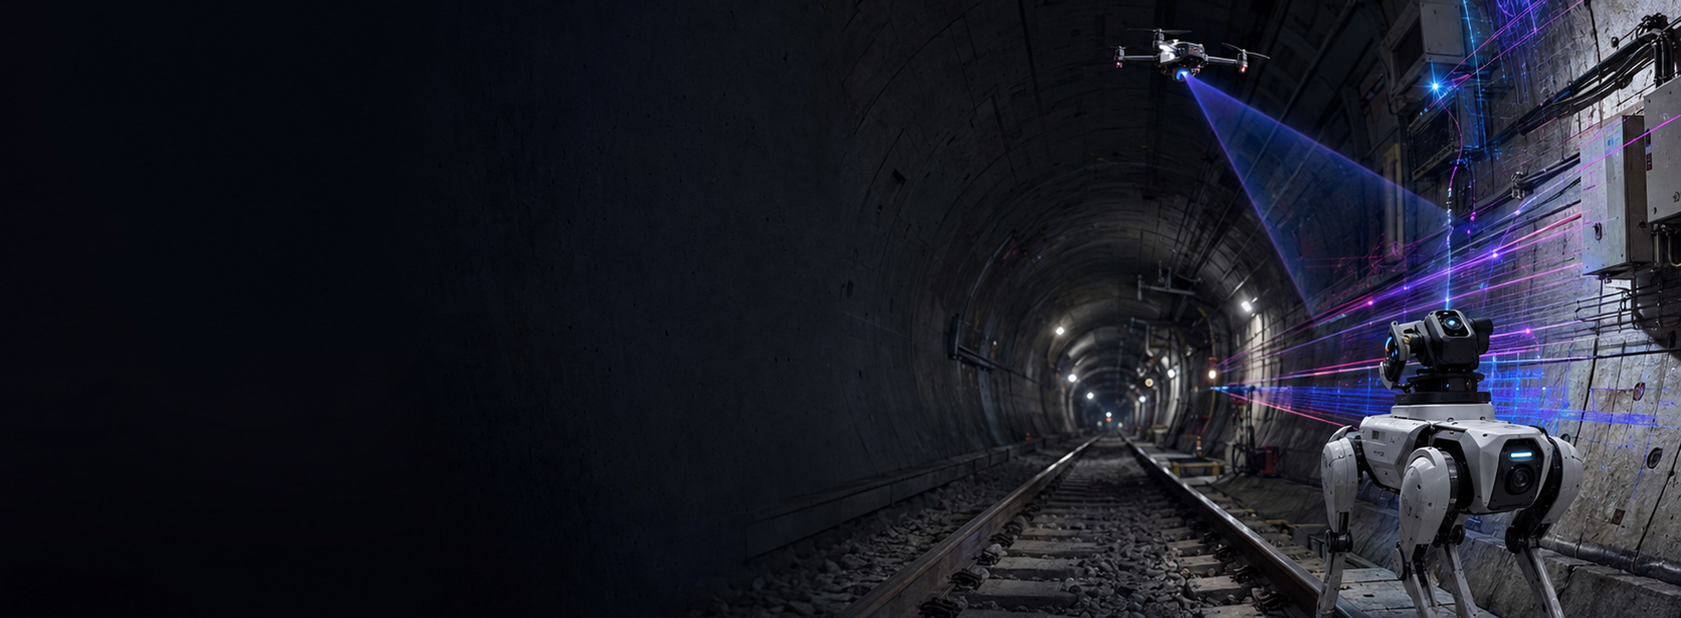
PHYSICAL INTELLIGENCE & ASSURANCE · INDUSTRY & INFRASTRUCTURE
Know the route is ready before the next movement.
RAIL, METRO & TUNNELS
OPERATIONAL PRESSURE
QUANTEON RESPONSE
Short access windows, confined geometry, live operational constraints and distributed structural and systems assets make repeatable inspection difficult and expensive.
Quanteon qualifies track and tunnel missions against asset context, then preserves exceptions, approvals and maintenance outcomes in one auditable record.
MISSION PORTFOLIO
Illustrative mission patterns · platform and payload subject to site qualification
Tunnel lining and water-ingress survey
Trackside equipment condition route
LiDAR · visual · thermal
Visual · thermal · acoustic
Bridge and viaduct close visual
Emergency smoke and gas map
Zoom · LiDAR · thermal
Gas · thermal · mapping
IDEAL CUSTOMER PROFILE
START WITH ONE MISSION
• Infrastructure and asset management
• Track, tunnel, structures and systems maintenance
• Safety, operations and emergency planning
Baseline one tunnel, station or trackside route within a controlled possession or non-operational window.
ASSURED MISSION BASELINE
SCOPE A MISSION →
10 working days · CHF 25k fixed · no hardware purchase
Sources: 49 CFR Part 213 Track Safety Standards; NTSB Joplin Derailment Investigation. Full links in the Quanteon Knowledge Base.
Concept missions only. No certification, production-readiness or autonomous safety-authority claim is implied. Human authority remains explicit.
16

Slide 17
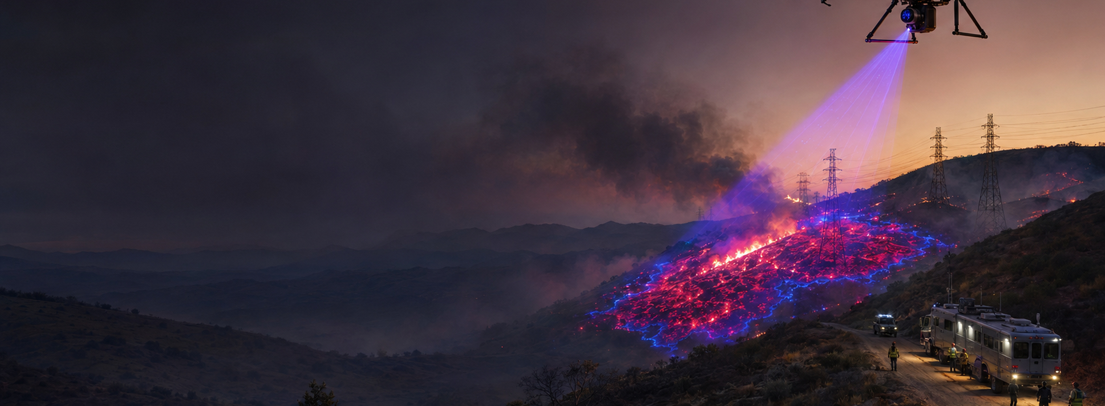
PHYSICAL INTELLIGENCE & ASSURANCE · SECURITY & RESPONSE
Persistent fire intelligence—qualified, deconflicted and traceable.
WILDFIRE & WUI RESPONSE
OPERATIONAL PRESSURE
QUANTEON RESPONSE
Wildfire teams need current perimeter, hotspot, route and infrastructure information while aircraft, ground crews, utilities and public-safety agencies share constrained airspace.
Quanteon organises sensing around command intent, makes flight and authority limits explicit, and preserves observations and decisions in one evidence-linked timeline.
MISSION PORTFOLIO
Illustrative mission patterns · platform and payload subject to site qualification
Perimeter and hotspot mapping
Utility corridor assessment
Radiometric thermal · mapping · EO
Zoom · thermal · LiDAR
Crew route and escape-zone update
Post-fire damage and re-ignition watch
Tracks · reports · terrain · weather
Thermal · visual · mapping
IDEAL CUSTOMER PROFILE
START WITH ONE MISSION
• Wildfire operations / emergency management
• Utility wildfire mitigation
• Forestry, land and public-safety UAS
Baseline one perimeter-and-hotspot or utility-corridor mission before fire season in a controlled exercise.
ASSURED MISSION BASELINE
SCOPE A MISSION →
10 working days · CHF 25k fixed · no hardware purchase
Sources: FAA UAS Wildfire Response; FAA Temporary Flight Restrictions. Full links in the Quanteon Knowledge Base.
Concept missions only. No certification, production-readiness or autonomous safety-authority claim is implied. Human authority remains explicit.
17

